Slide 1
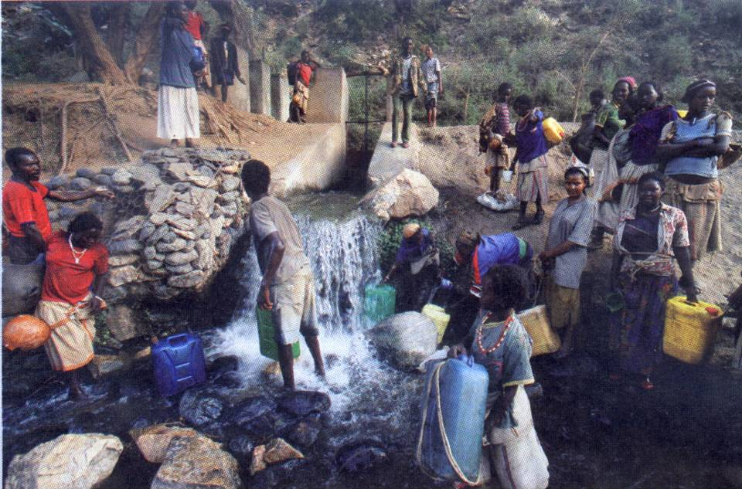
Grand challenge: Affordable Adequate Water for All
Water security, in terms of Quantity and Quality,
poses a problem for both the developed and developing world
Eilon M. Adar
Ben-Gurion University of the Negev
Blaustein Institutes for Desert Research
The Zuckerberg Institute for Water Research

Slide 2
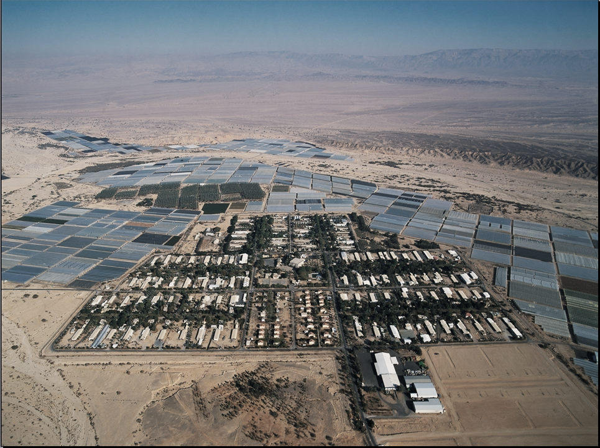
Water is a synonym for food !
Notes:
2

Slide 3
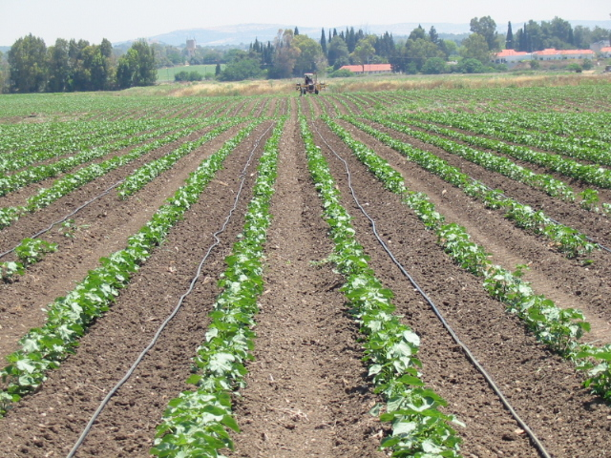
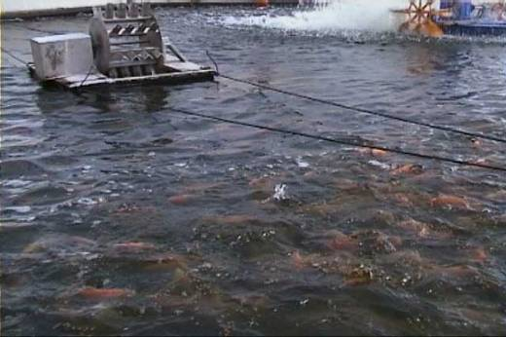
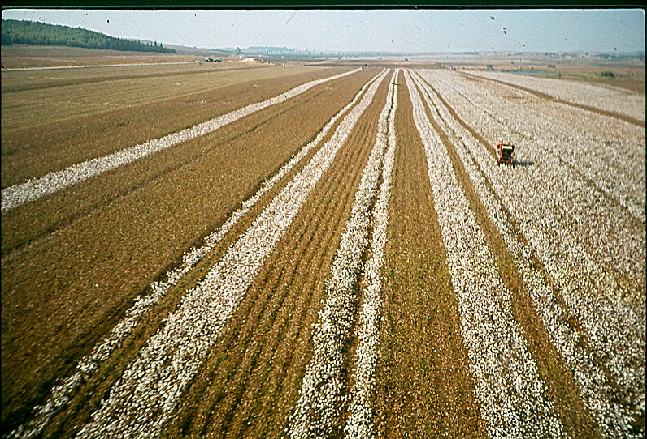
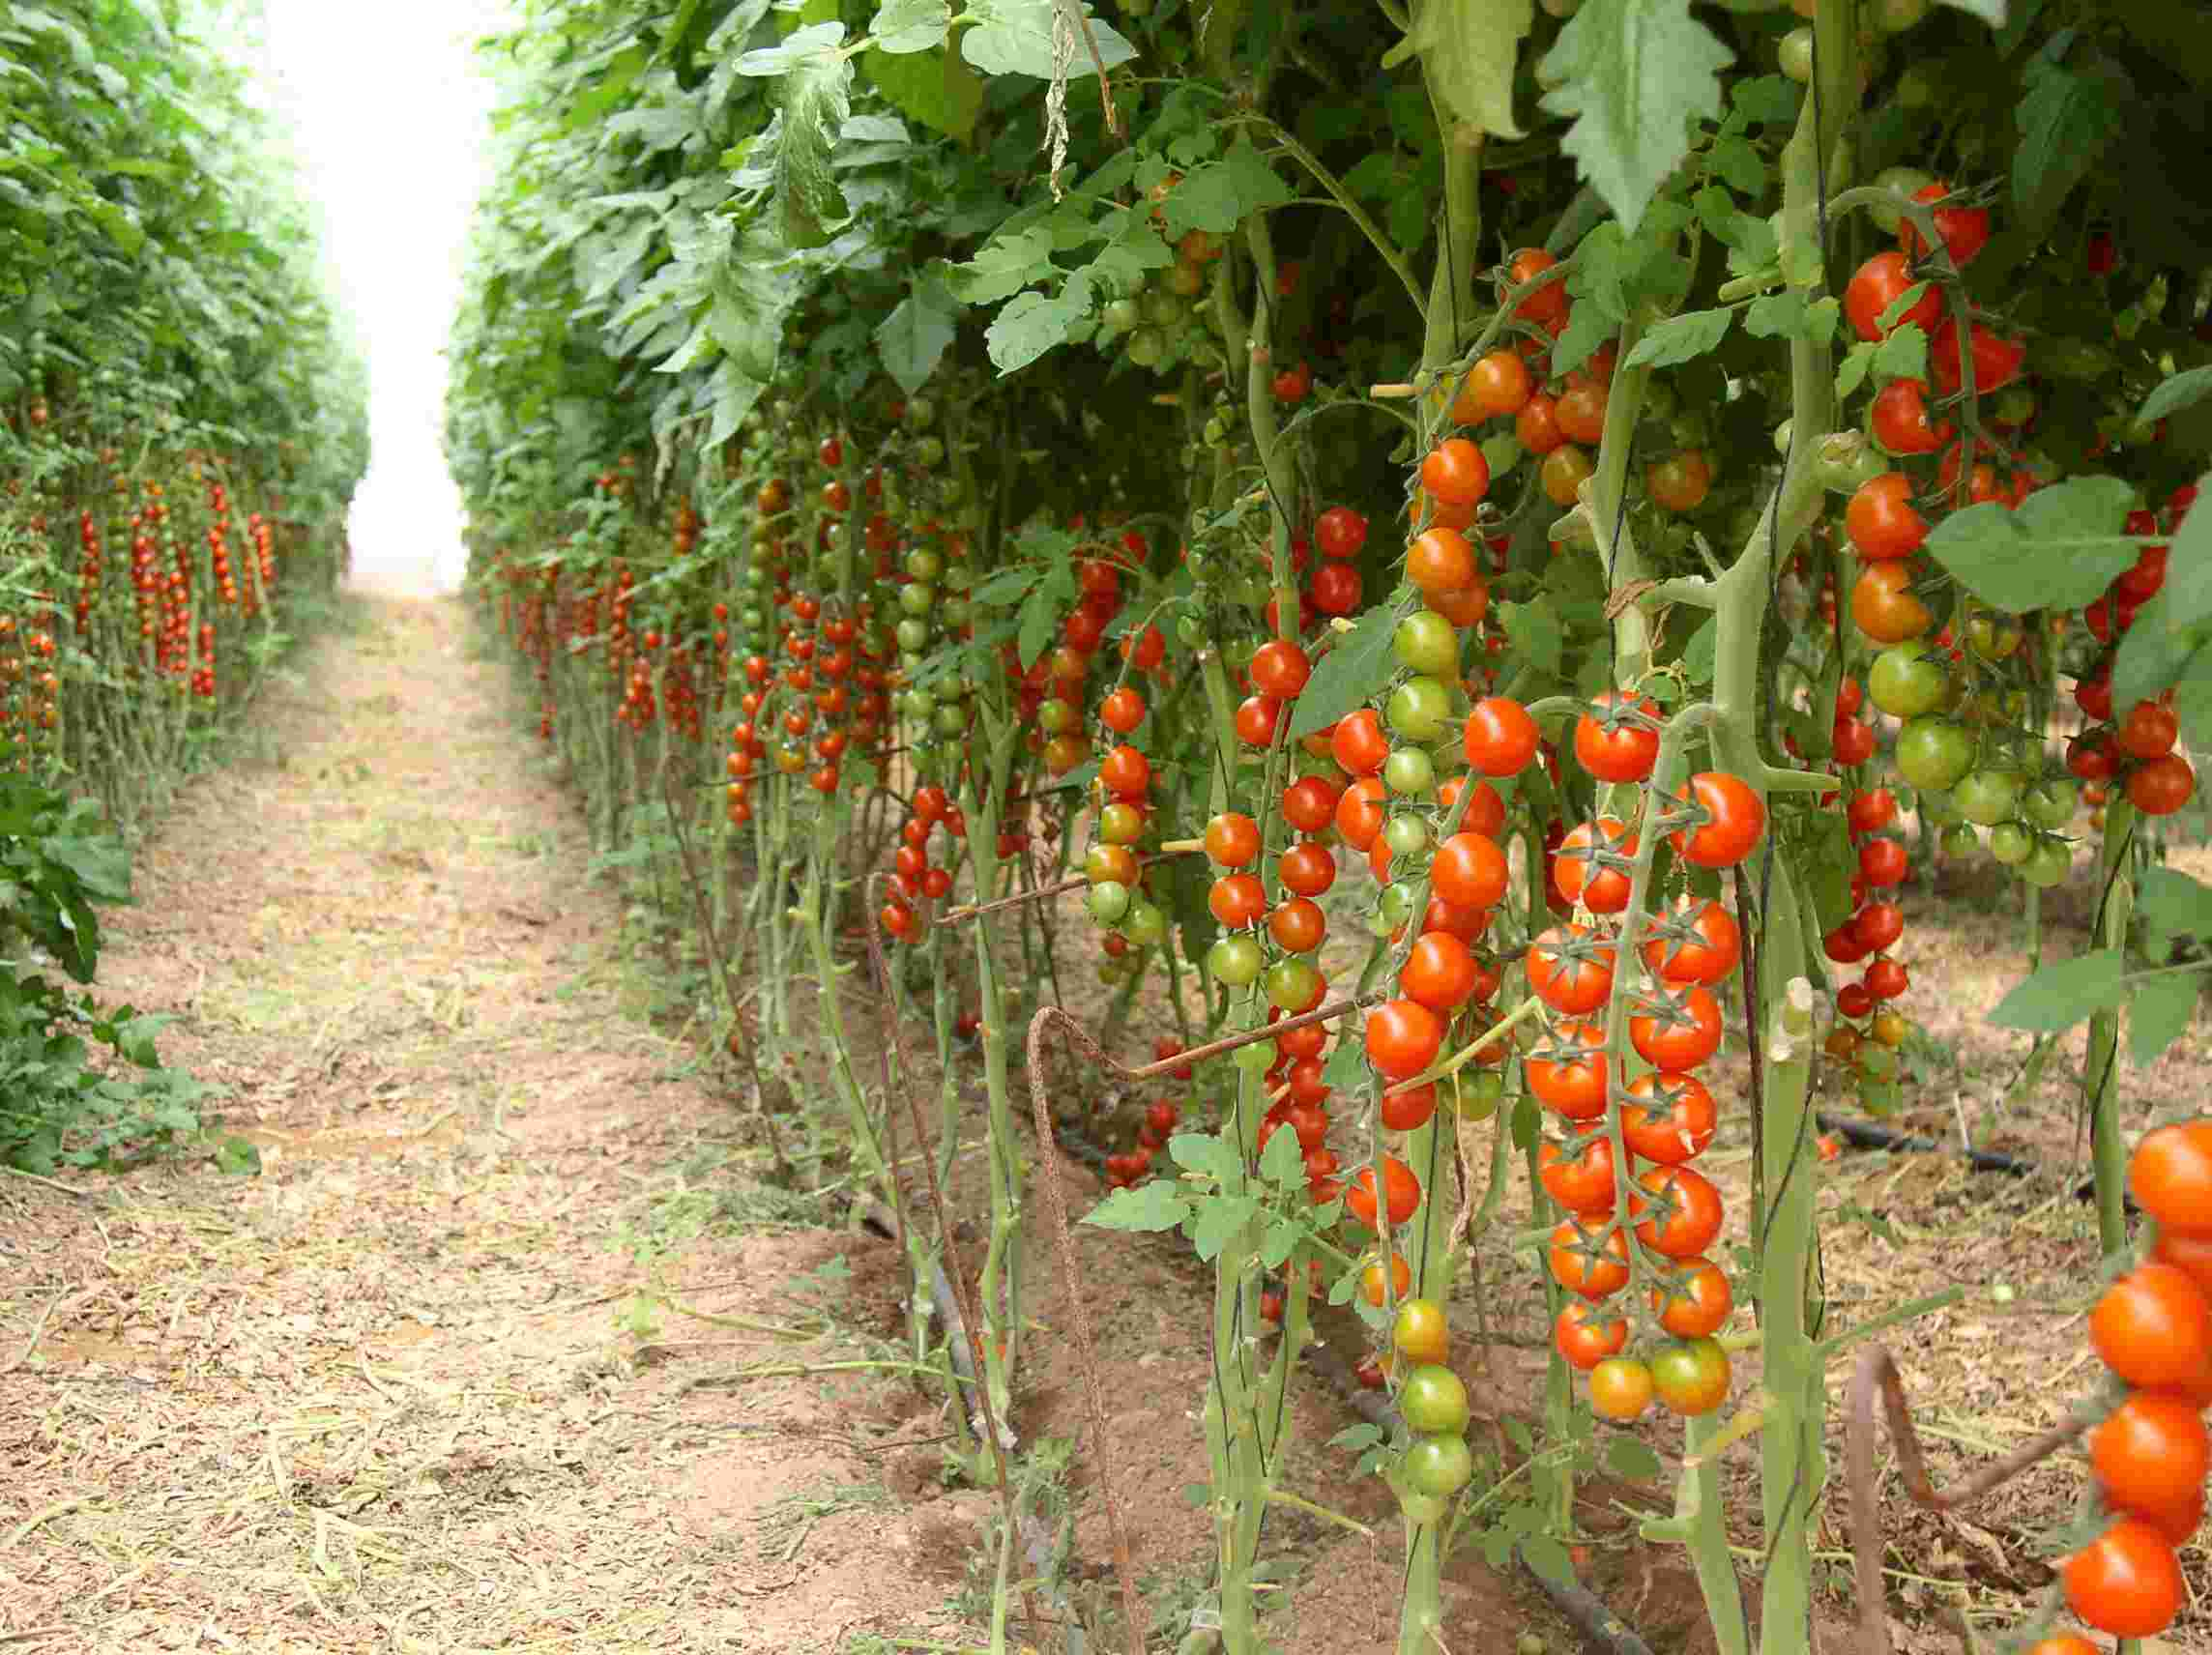
Humanity has to produce more food with a lower availability of water
While water is diminishing, the demand for food is increasing.

Slide 4
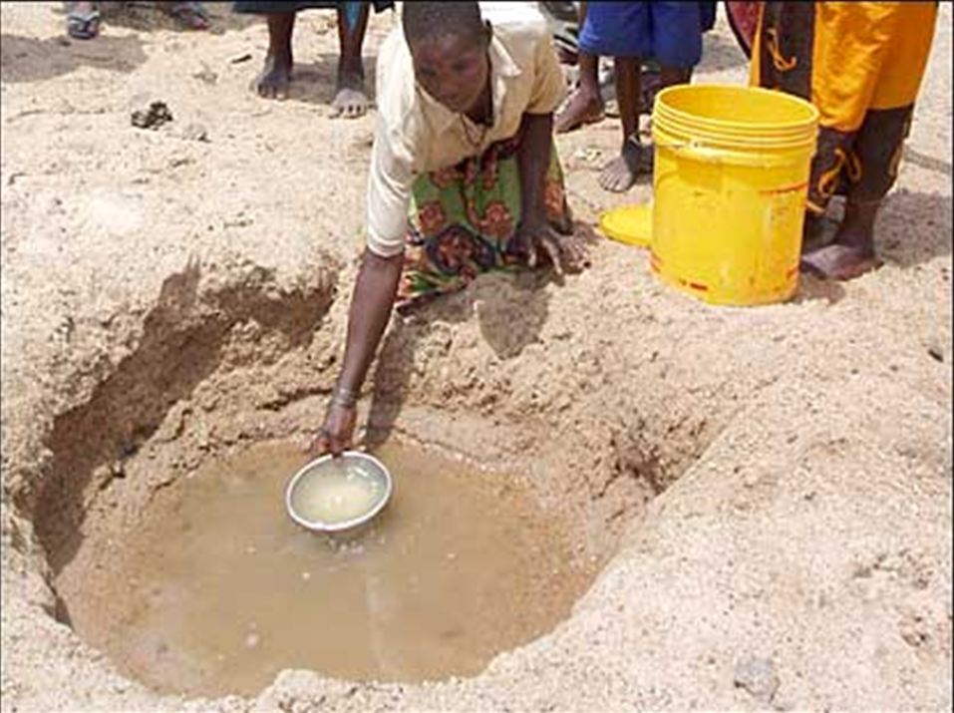
Will the conventional policy of Water Saving & Increasing Water-Use Efficiency enable humanity to avoid water shortages and provide water security?
At most, it will only temporarily mitigate water scarcity!
One cannot sustain the water and food supply with a diminishing amount of water and a continuously growing population.

Slide 5
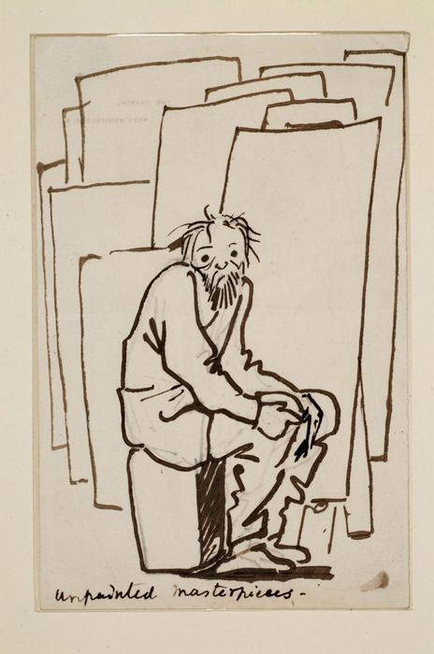
SHALL WE DESPAIR ???
Affordable water: decreasing the cost of water production
&
lowering the demand for energy

Slide 6
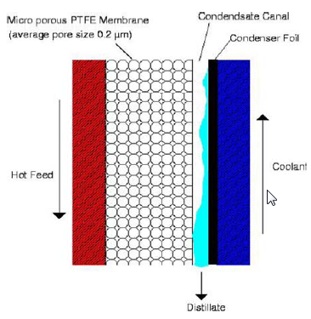
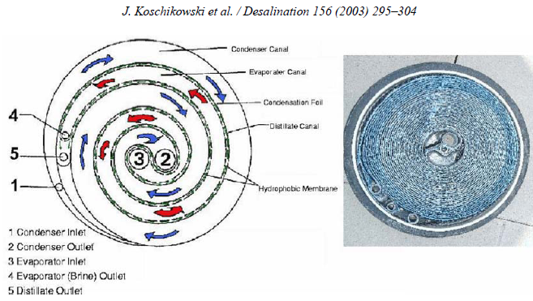
The critical barrier:
Construction of hydrophobic membranes for vapor distillation -- resisting bio-fouling & scaling.
Heat gradient rather than pressure gradient.
Vapor transfer rather than liquid.
Porous hydrophobic membrane with specific nano- morphology.
Avoiding precipitation of scaling by minerals.
Avoiding accumulation of Bio-Fouling.
Goals for the Next Generation of Desalination: Decreasing the cost!

Slide 7
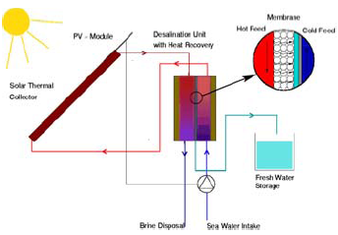
The critical path:
Removal of dissolved salts under low pressure through affordable selective porous membranes.
Removal of dissolved and suspended pollutants through resistant, yet highly permeable, membranes.
Driving force by temperature gradient achieved by solar heated water rather than by reinforced hydrostatic pressure.

Slide 8
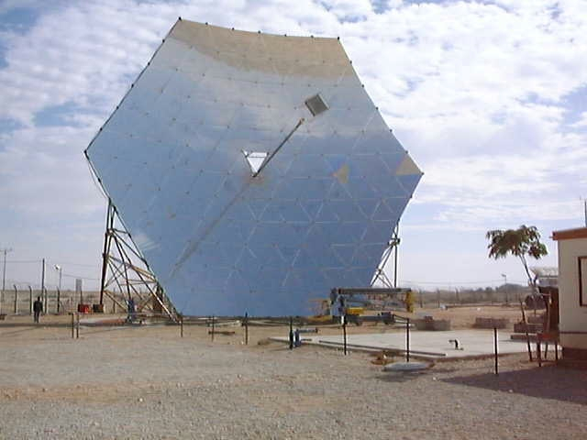
Solar Desalination System
1 M3 / water by RO =~3.75 KW/hr
Solar heated vapor distillation -- decreases desalination cost by 50%!
Affordable water from various types of raw water: salty, brackish & contaminated groundwater and / or sea water.
Advantages: relatively cheap water can be produced even by small plants located in rural communities in dryland regions.
Notes:
8

Slide 9
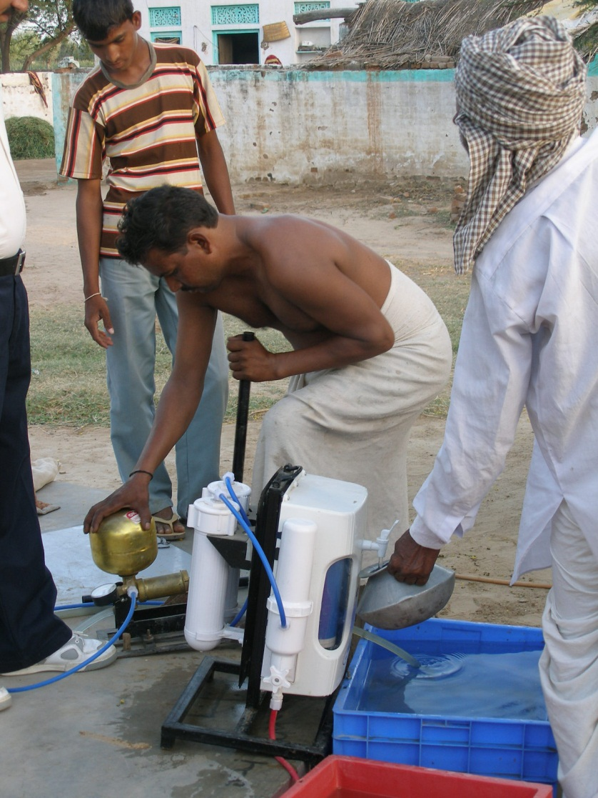
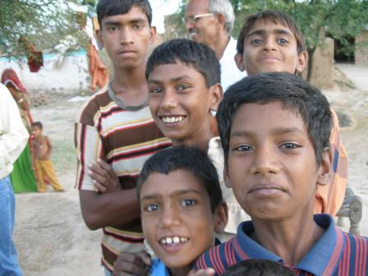
Once achieved, the big barrier to broad dissemination is a lack of basic and technical education for operation & maintenance.
EDUCATION !!!
Computerized Irrigation System !
Notes:
9

Slide 10
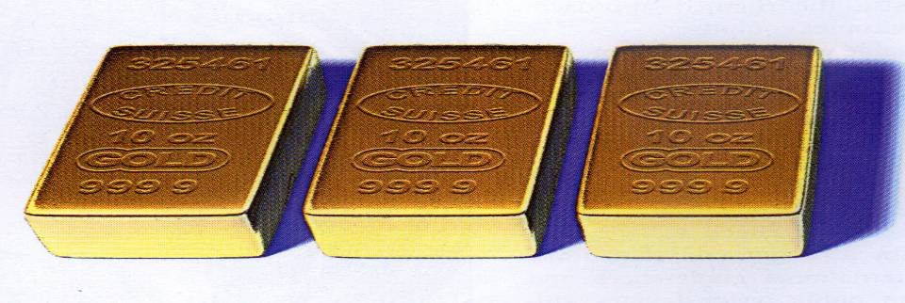
Unlike gold, water needs care & attention

