Slide 1
Ending Energy Poverty
through Science and Cooperation

Slide 2
Energy Inequality

Slide 3
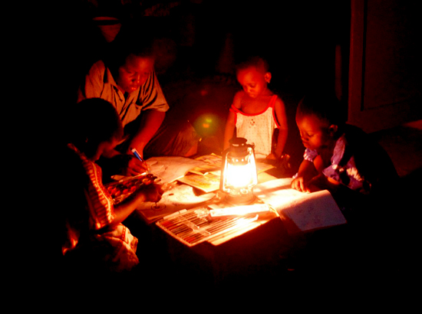

Slide 6
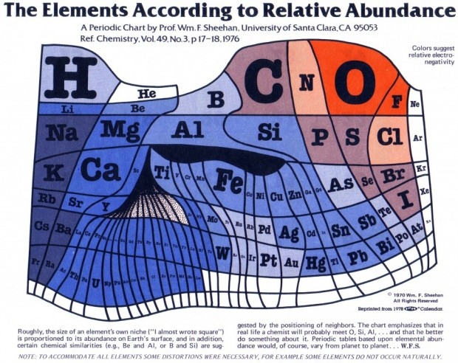

Slide 7
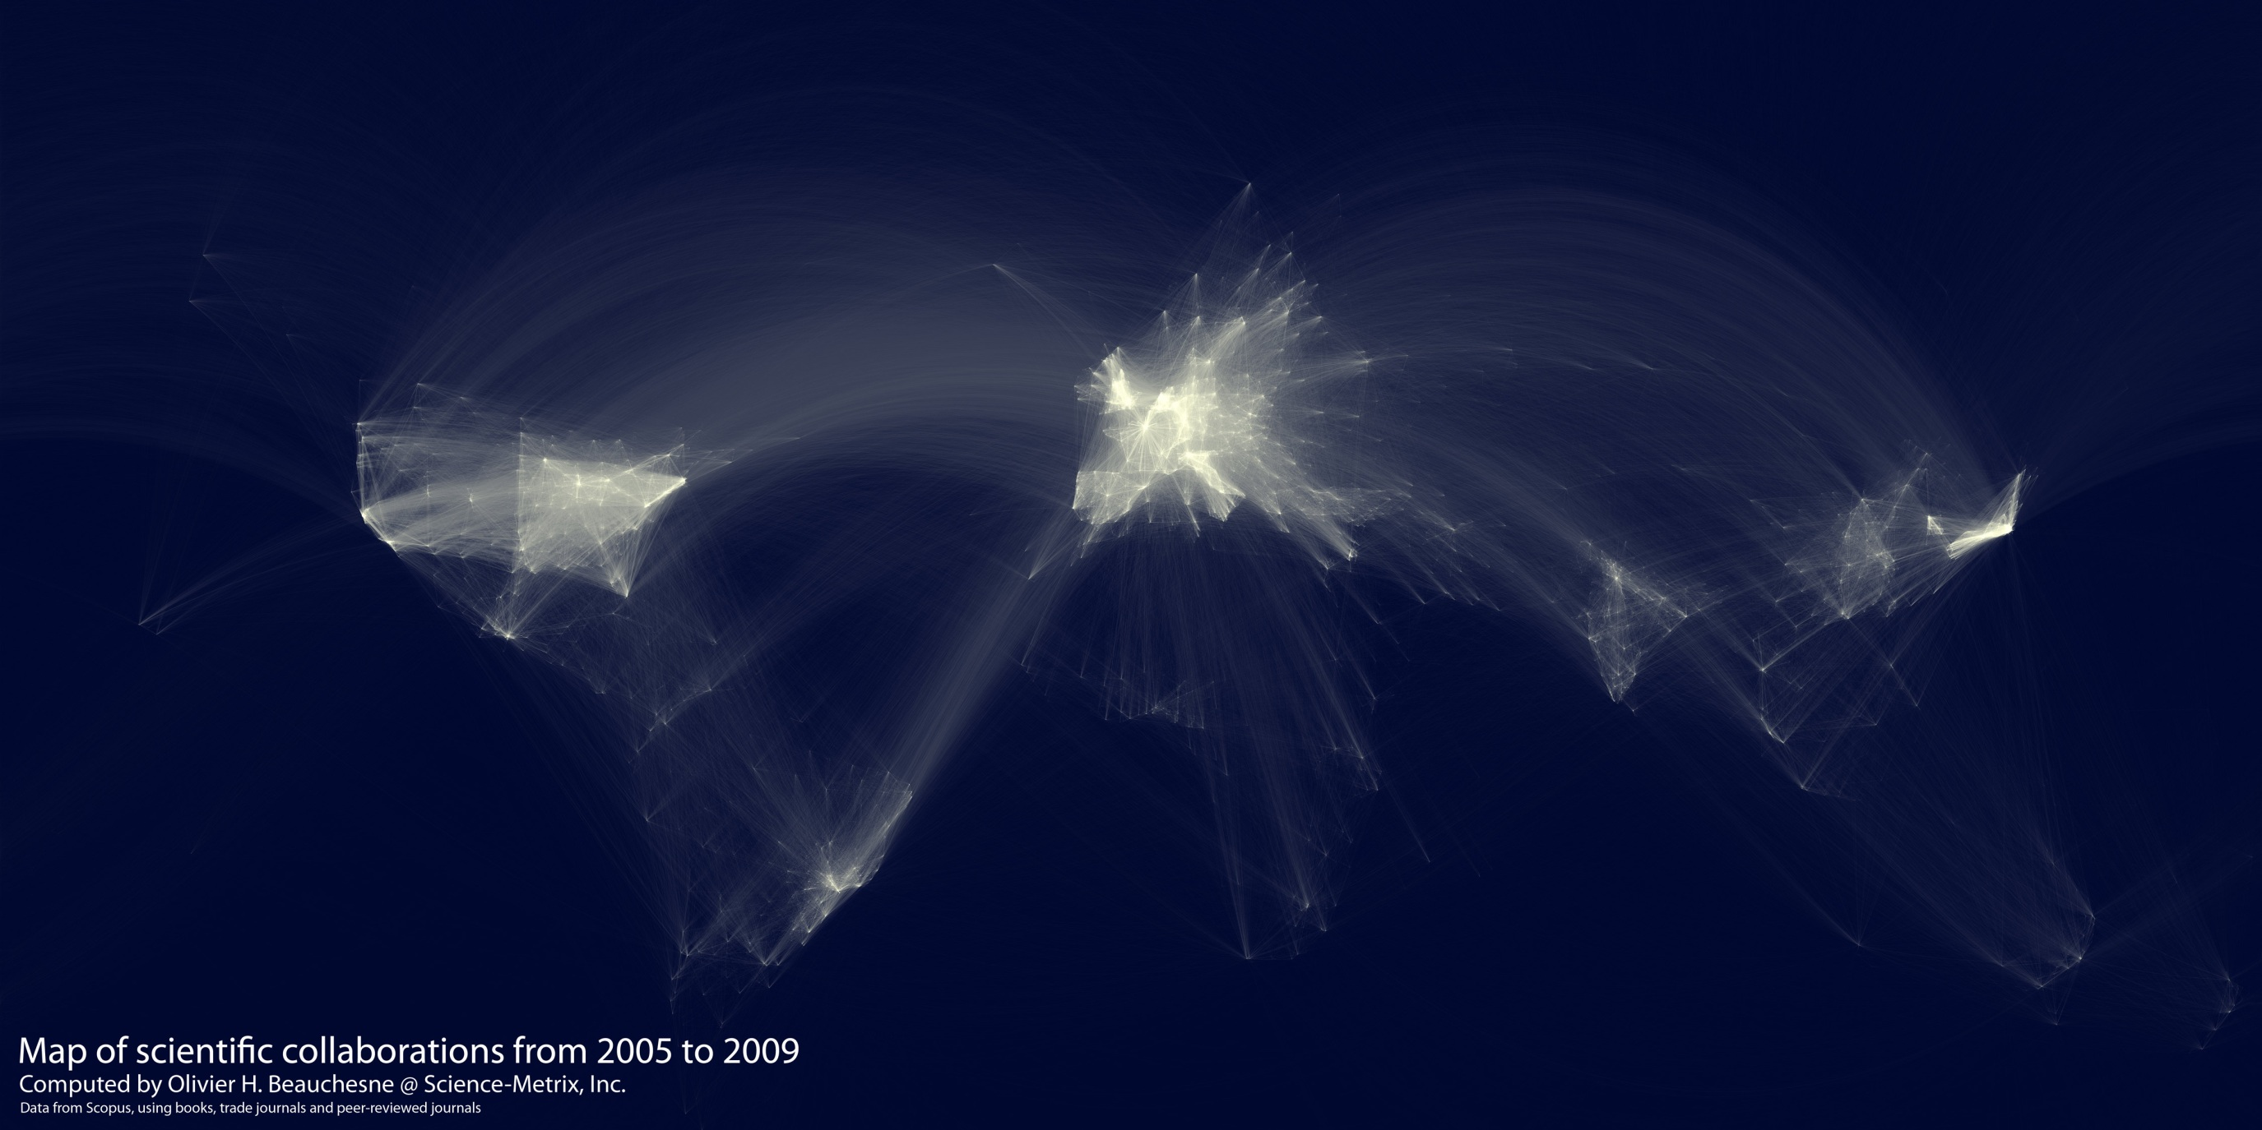
Map of Scientific Collaborations

Slide 8
Unlocking the Emerging Potential

Slide 10
IAP Call for
Sustainable
Energy
Solutions

Slide 11
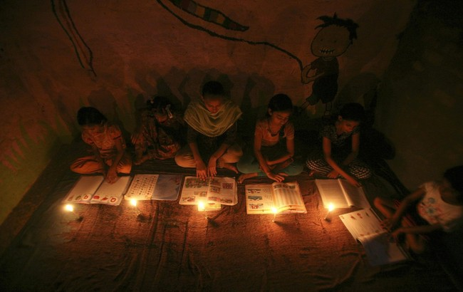

Slide 12
Ending Energy Poverty
through Science and Cooperation

