Slide 1


The IAP Young Physician Leaders (YPL) Programme
Empowering Young Global Health Leadership – The Leadership We Want
World Health Summit, 2021
YPL Program Leaders and Alumni Steering Committee

Slide 2
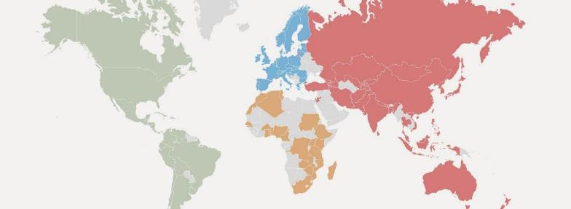




IAP: The global network of academies of science, medicine and engineering
149 member academies
4 regional networks
>30,000 leading scientists, engineers and health professionals in over 100 countries

Slide 3




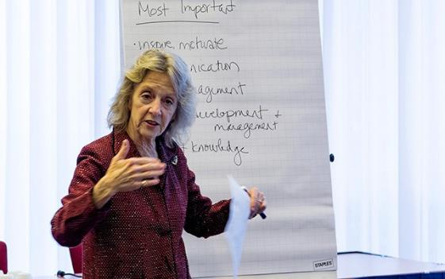
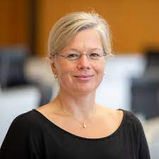
Young Physician Leaders
This IAP programme has the collaboration of the European School of Management and Technology (ESMT Berlin) with the support of the Tides Foundation, the Charité, Universitätsmedizin Berlin and the Bayer Foundation.
The programme is coordinated by Jo Boufford (IAP) and Nora Grasselli (ESMT Berlin)

Slide 4

Young Physician Leaders
IAP-ESMT YPL prgogramme ranked #1 in the:
https://executivecourses.com/lists/top-10-executive-courses-in-healthcare

Slide 5
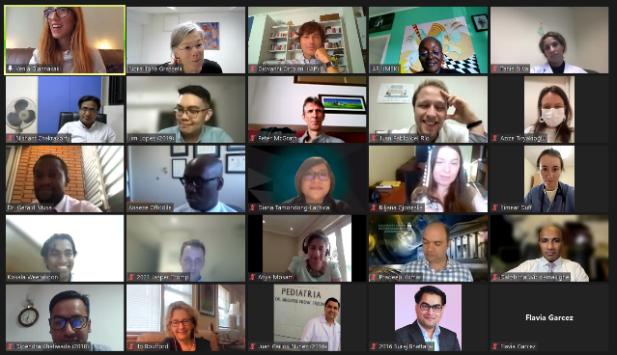
Young Physician Leaders
2021 YPL cohort met online for a met and greet session. They will meet in-person for their leadership training workshop June 2022.
The annual YPL session at the WHS designed and presented by a new cohort of YPL will therefore be delivered by a group of alumni from the programme: Biljana Gjoneska, Dipendra Khatiwada, Jaifred Christian Lopez, Atiya Mosam and Juan Carlos Núñez-Enríquez, who are some of the members of the YPL Alumni Steering Committee.

Slide 6


Slide 7
Creating Impact Through Young physician Leadership – Areas of Action”
Introduction, Leadership in Research and Science
BILJANA GJONESKA, MD, PhD, Research Associate
Macedonian Academy of Sciences and Arts, North Macedonia

Slide 8
YPL AT A GLANCE
Africa
South America
Represented countries
Egypt, Cameroon, Congo, Ghana, Kenya, Morocco, Nigeria, South Africa, Sudan, Tanzania, Uganda, Zambia
Represented countries
Argentina, Brazil. Chile, Colombia, Ecuador, Guatemala
22
Europe
50
Represented countries
Croatia, Finland, France, Germany, Greece, Ireland, Italy, Latvia, Lithuania, Macedonia, Netherlands, Portugal, Romania, Spain, Turkey, Sweden, Hungary, UK
Australia
Asia
10
North America
45
11
Represented countries
Bangladesh, China, India, Iran,J apan, Laos, Lebanon, Malaysia, Mongolia, Nepal, Pakistan, Sri Lanka, Thailand, Turkey, Philippines, Russia, Singapore, Vietnam
Represented countries
Canada, United States of America (Chicago, Louisiana, Maryland, Massachusetts, New York, Texas), Mexico, Jamaica
75
IN 10 YEARS OF EXISTENCE THE YPL PROGRAM TRAINED
OVER 200 MEDICAL PROFESSIONALS UNDER THE AGE OF 40
Notes:
© Copyright PresentationGO.com – The free PowerPoint template library
8

Slide 9
YPL IN FIGURES
Genetics (5)
Anatomy
Histology
Neurosciences
Bioinformatics
Internal medicine (57)
Cardiology
Neurology
Endocrinology
Nephrology
Surgery (18)
Neurosurgery
Orthopedics
Ophthalmology
Infectious Medicine (16)
Psychiatry (10)
Gynecology (9)
Public
health (46)
Epidemiology (9)
Family
medicine (2)
Mental
Health (1)
Occupational health (1)
GENDER DISTRIBUTION
2011-2021
SPECIALTY DISTRIBUTION
2011-2021

Slide 10
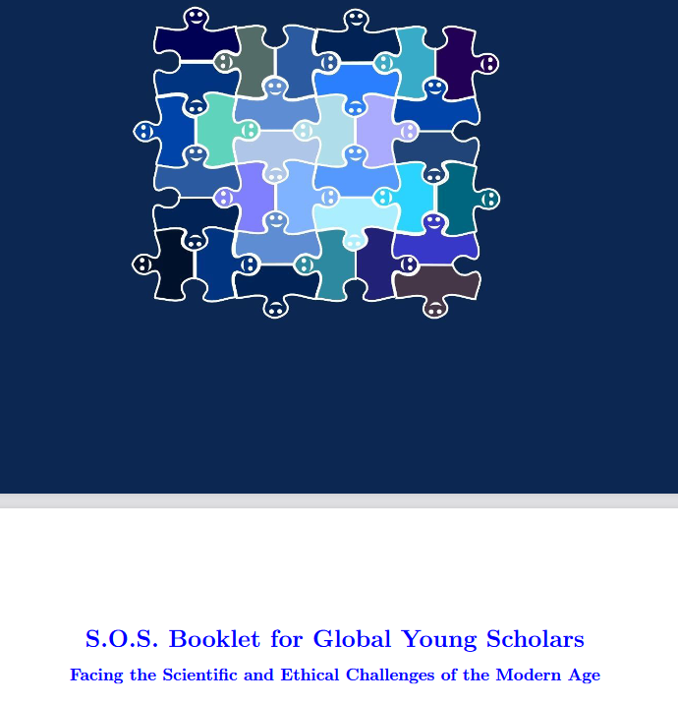
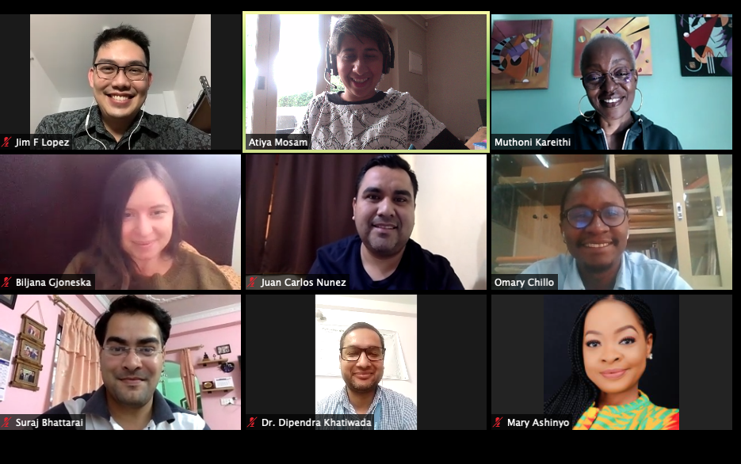
YPL MILESTONES
PUBLICATIONS
Gee, R. E., Jarvinen, T., Sultana, T. A., Destura, R., & Gjoneska, B. (2012). IAMP tackles a void in medical education: Leadership. Lancet, 379(9813):e25
Giles, M. L., Vincent, F. B., Volkenstein, S., Shefin, S. M., Silva, A., & Fredrick, F. (2014). What has the Young Physician Leaders Programme achieved? Lancet, 384(9937), 26-27.
Gjoneska, B. et al. (2020). S.O.S. Booklet for Global Young Scholars. Budapest: GYA/IAP Young Researchers Leadership Workshop in the Framework of the WSF 2019
10-YEAR JUBILEE
YPL ALUMNI STEERING COMMITTEE LAUNCHED

Slide 11
YPL ALUMNI STEERING COMMITTEE
ATIYA MOSAM (2019 Cohort), Johannesburg, SOUTH AFRICA
Public Health Medicine Specialist
Senior Researcher at the SAMRC/WITS Center for Health Economics and Decision Science,
BILJANA GJONESKA (2011 Cohort), Skopje, NORTH MACEDONIA
Research Associate at the Macedonian Academy of Sciences and Arts
JAIFRED LOPEZ (2019 Cohort), Manila, PHILIPPINES
Assistant Professor at the College of Public Health, University of the Philippines
JUAN CARLOS NUÑEZ-ENRIQUEZ (2016 Cohort), MEXICO
Pediatrician & Research Associate at the Mexican Institute of Social Security,
UMAE Hospital de Pediatría Centro Medico Nacional Siglo XXI
SURAJ BHATTARAI (2016 Cohort), Kathmandu, Bagmati, NEPAL
Research Fellow & Founding Executive Member at the Global Institute for Interdisciplinary Studies
DIPENDRA KHATIWADA (2018 Cohort), Janakpur, NEPAL
Surveillance Medical Officer at the World Health Organization,
OMARY CHILLO (2017 Cohort), TANZANIA
Head of Department of Physiology, Muhimbili University of Health & Allied Sciences

Slide 12
LEADERSHIP CHALLENGES IN RESEARCH & SCIENCE
YOUNG SCIENCE LEADERS AS MODERN POLYMATHS
Model scientists
Communicator scientists
Mindful scientists
Entrepreneur scientists
Reflective scientists
Inspiring scientists

Slide 13
YPL LESSONS FOR LEADERSHIP IN RESEARCH & SCIENCE
MODELING THE MODEL SCIENTISTS:
The legacy of YPL mentoring program
NETWORKING WITH COMMUNICATOR SCIENTISTS:
The benefits of multinational collaborations
    Research projects
    Research studies
Community of mindful scientists:
The importance of YPL Alumni Steering Committee
  Global ward round series
  Vaccine hesitancy webinars
  Grant proposals
  Joint publications

Slide 14
Creating Impact Through Young physician Leadership – Areas of Action”
Leadership in Education
JAIFRED CHRISTIAN F. LOPEZ, Assistant Professor/Special Assistant to the Dean
College of Public Health, University of the Philippines/TROPMED Philippines

Slide 15
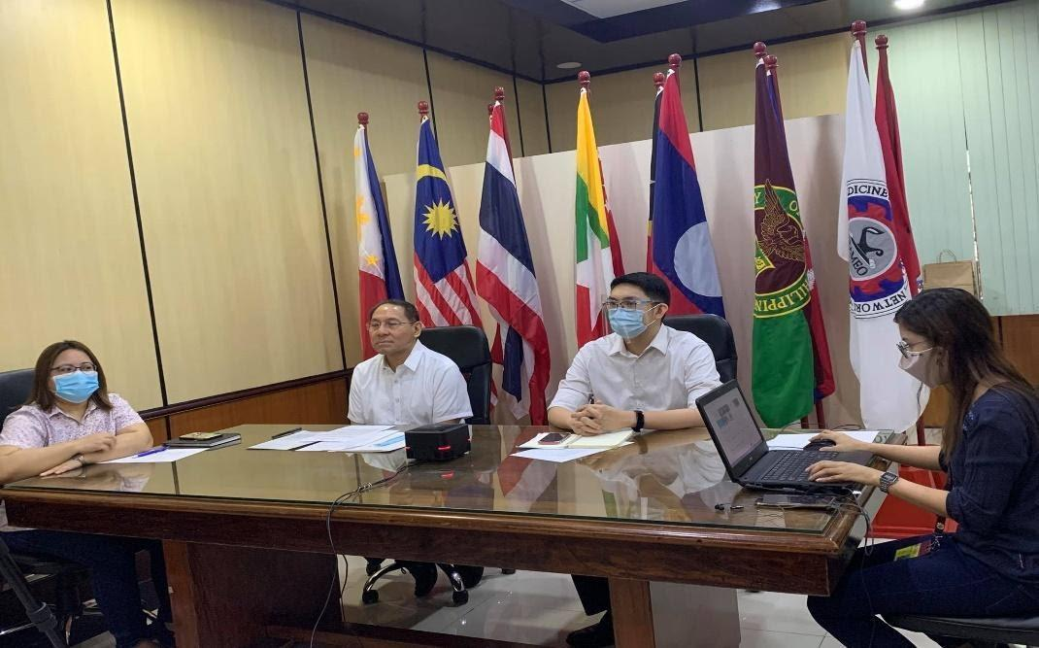
LEADERSHIP CHALLENGES IN EDUCATION
Education institutions are responsible for teaching, research and service, especially, in the health professions. The COVID-19 pandemic adversely affected these areas.
Four challenges (Bhagat & Kim, 2020): Crisis preparedness, concerns on quality of remote learning, financial, online delivery → Digital resilience as way forward
Despite difficulties amid the pandemic, innovation is still possible (Simbulan, 2020)
Key leadership values in these times: equity, shared leadership, trust-building, transparent and clear communication (Kruse, Hackmann & Lindle, 2020; Dumulescu & Mutiu, 2021; Kezar, nd)

Slide 16
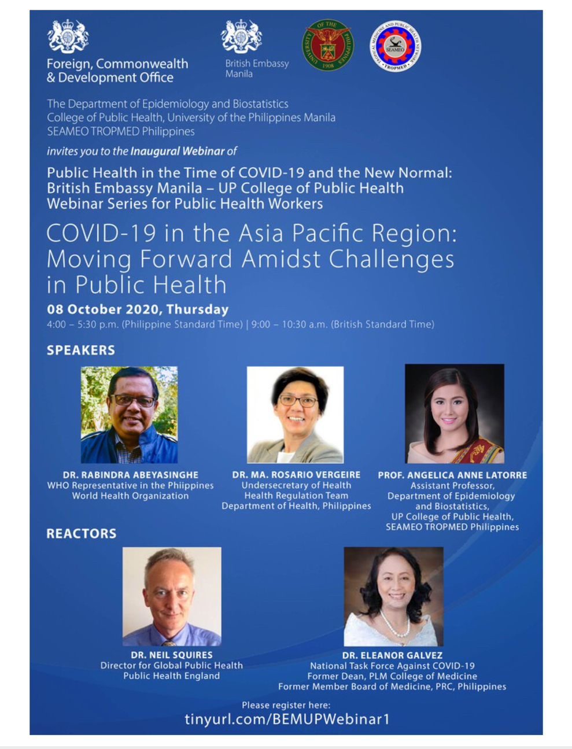
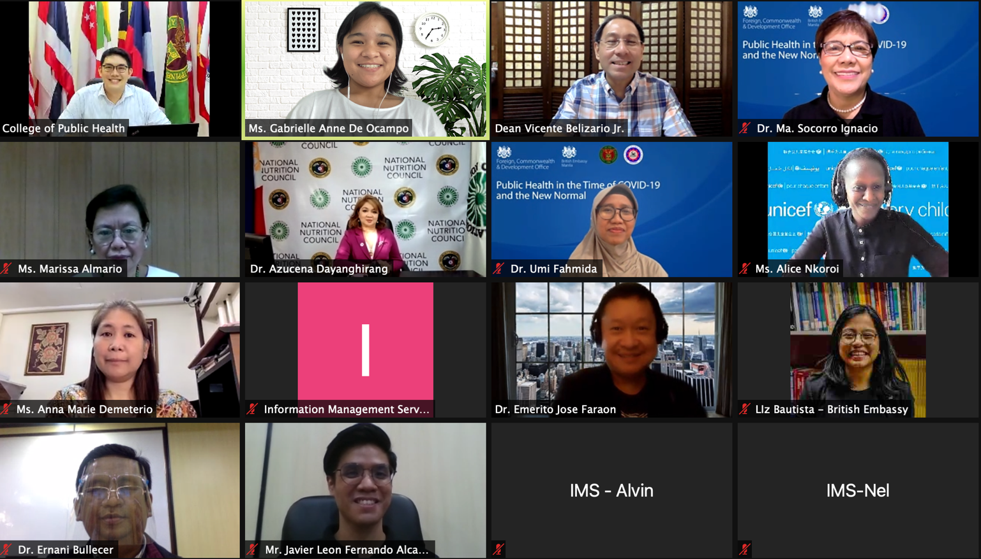
LEADERSHIP CHALLENGES IN EDUCATION
(con’td)
Our experience:
  Pandemic accelerated an already ongoing process towards blended learning (e.g., master of public health program for rural physicians, regular courses);
  Uncertainty on public health guidelines
  Challenges with online tasks and work-life balance
  Sickness and demise of colleagues, and difficulty in addressing mental health needs
  Strengthening community spirit (e.g., virtual flag ceremonies, community events)
  Enhancing engagement with stakeholders, community, partner agencies

Slide 17
Creating Impact Through Young physician Leadership – Areas of Action”
Leadership in Public Health
DIPENDRA KHATIWADA, World Health Organization, Nepal

Slide 18
Leadership in Public Health
Lasting impact in health at local, national and global levels
Leading in policy and organizational transformation
Problem-solving strategies
Influence community through knowledge-based ideas and approaches
Informed leader who is equipped to take on complex public health challenges
Coordination and multisectoral approach
Notes:
by leading teams, managing projects, and designing solutions.

Slide 19
Creating Impact Through Young physician Leadership – Areas of Action”
Leadership in Clinical Practice
JUAN CARLOS NUÑEZ-ENRIQUEZ, MD, PhD, Pediatrician & Research Associate
UMAE Hospital de Pediatría Centro Medico Nacional Siglo XXI, IMSS

Slide 20

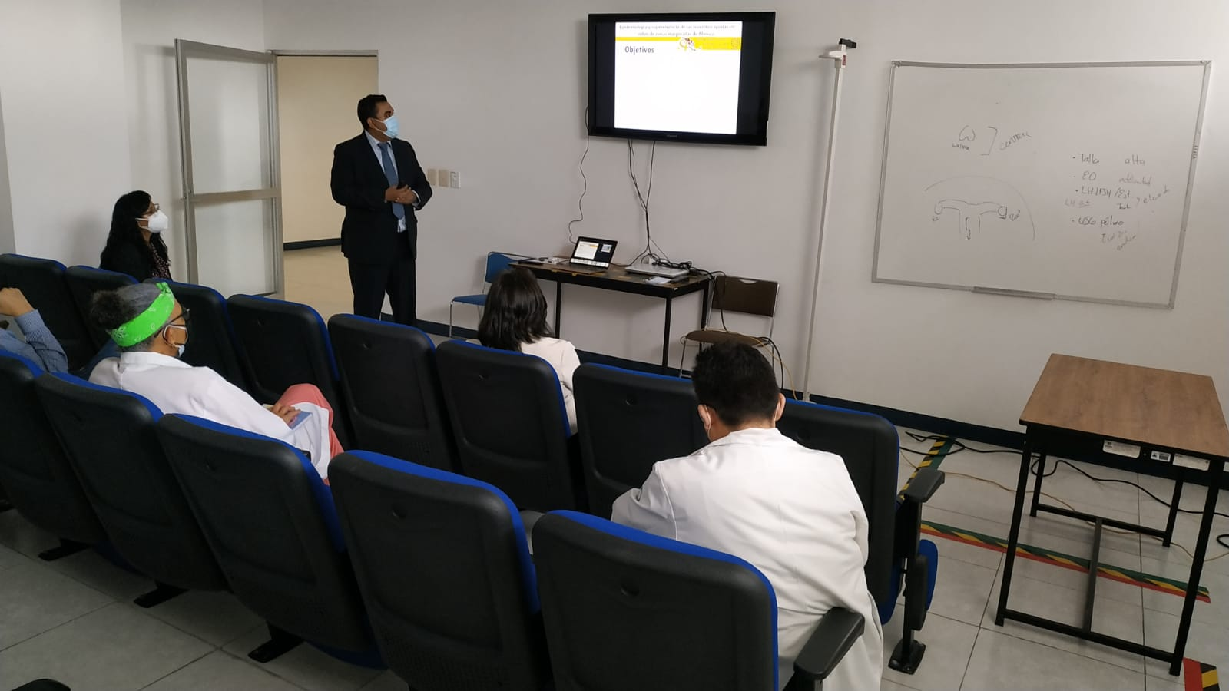
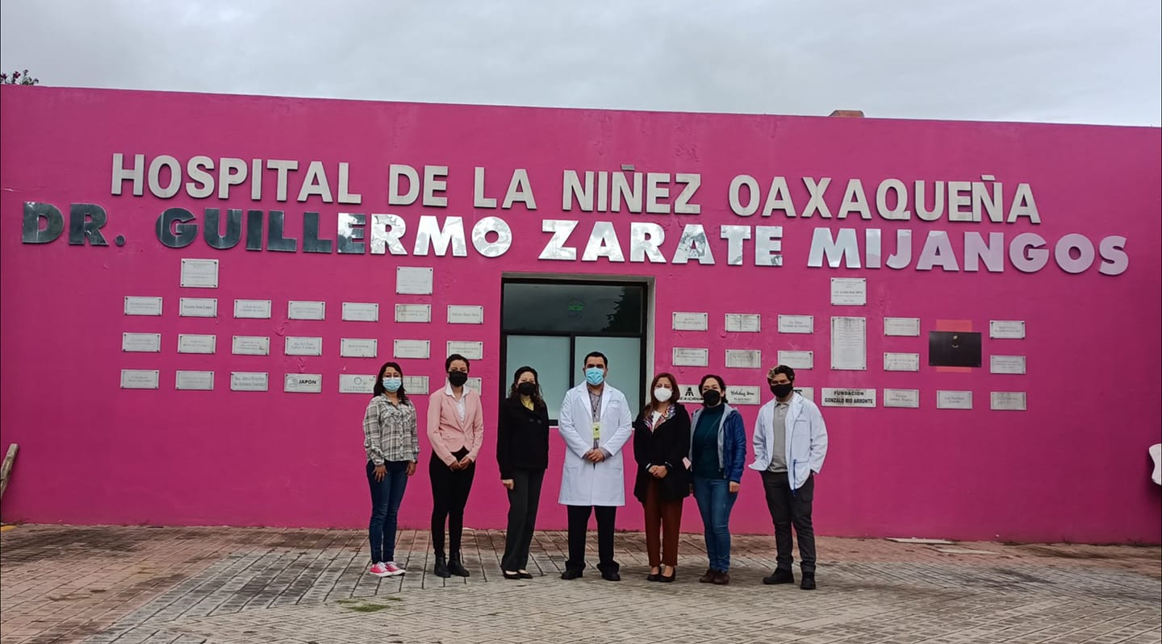
YPL LESSONS FOR LEADERSHIP IN CLINICAL PRACTICE
Childhood leukemia is the main type
of cancer in Mexican children
Elevated incidence and mortality rates of this disease in poor regions of Mexico (Oaxaca, Puebla, Tlaxcala) were exacerbated during the current pandemic.
Availability of diagnostic tools and access to treatment were also limited in these populations
Leaders in clinical practice, supported by the current Mexican Government through CONACYT, started a strategic plan to implement actions in order to solve this problem.
FORDECYT-PRONACES-377883-2020

Slide 21
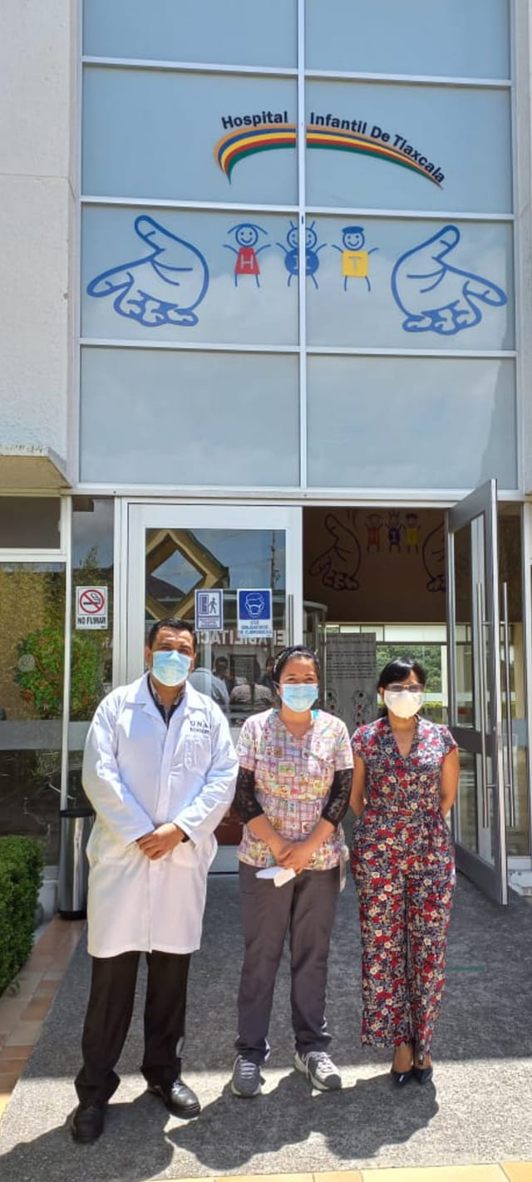
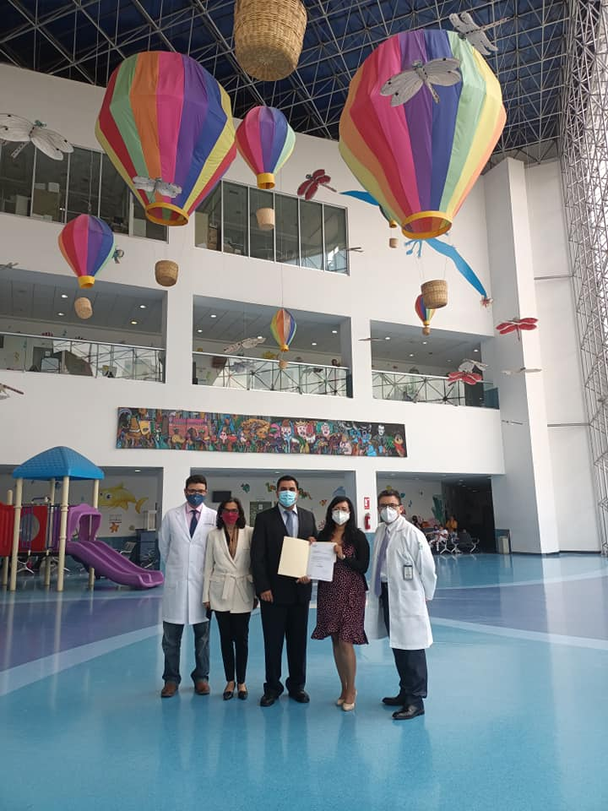

YPL LESSONS FOR LEADERSHIP IN CLINICAL PRACTICE
Leadership in clinical practice must be put in action for attending health problems of the most vulnerable populations.
The formula: Clinicians with leadership capacities, social commitment and skills for professional practice, seeking to promote research and inter-institutional collaboration with different sectors of society.

Slide 22
Creating Impact Through Young physician Leadership – Areas of Action”
Leadership and the Social Impact
ATIYA MOSAM, MD, FCPHM, MPH, MMed, Public Health Physician and Senior Researcher, SAMRC/WITS Center for Health Economics and Decision Science, University of the Witwatersrand

Slide 23


Thank you!
Email: iap@twas.org
Website: www.interacademies.org
Twitter: @IAPartnership
LinkedIn: www.linkedin.com/company/interacademypartnership
YouTube: https://tinyurl.com/IAPyoutube
Notes:
23

