Slide 1
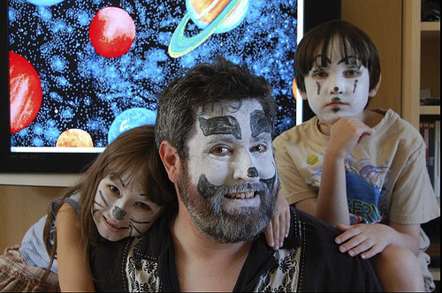

Slide 7
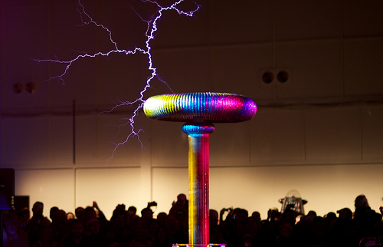
This →
← Not This

Slide 10
Grand Challenge:
Know your audience
Who are they?
What do they know?
What matters to them?
Communication is about them, not you

